Slide 1
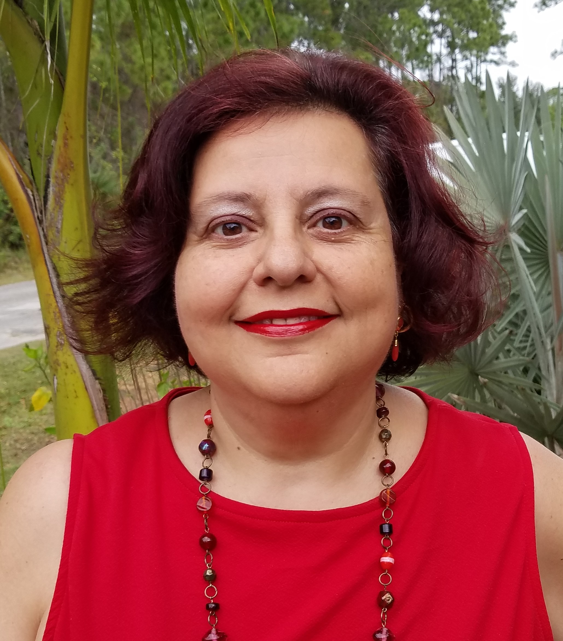
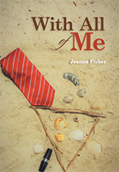
www.JoannesBoooks.com
Published Author,
Instructor & Public
Speaker
Presented by
Joanne Fisher
So, You Want To Write A Novel!
Join Joanne Fisher as she presents tips, information & “insider experience” of how to break into the amazing world of Authorship!
Saturdays
10am – 12pm
Beginning
March 11, 2023
at Franklin T. DeGroodt Public Library
6475 Minton Rd SE,
Palm Bay, FL 32908
Joanne’s catalogue includes:
Romance, Historical Fiction, Murder Mystery, Travel Guides, Short Stories & more!

